Slide 1

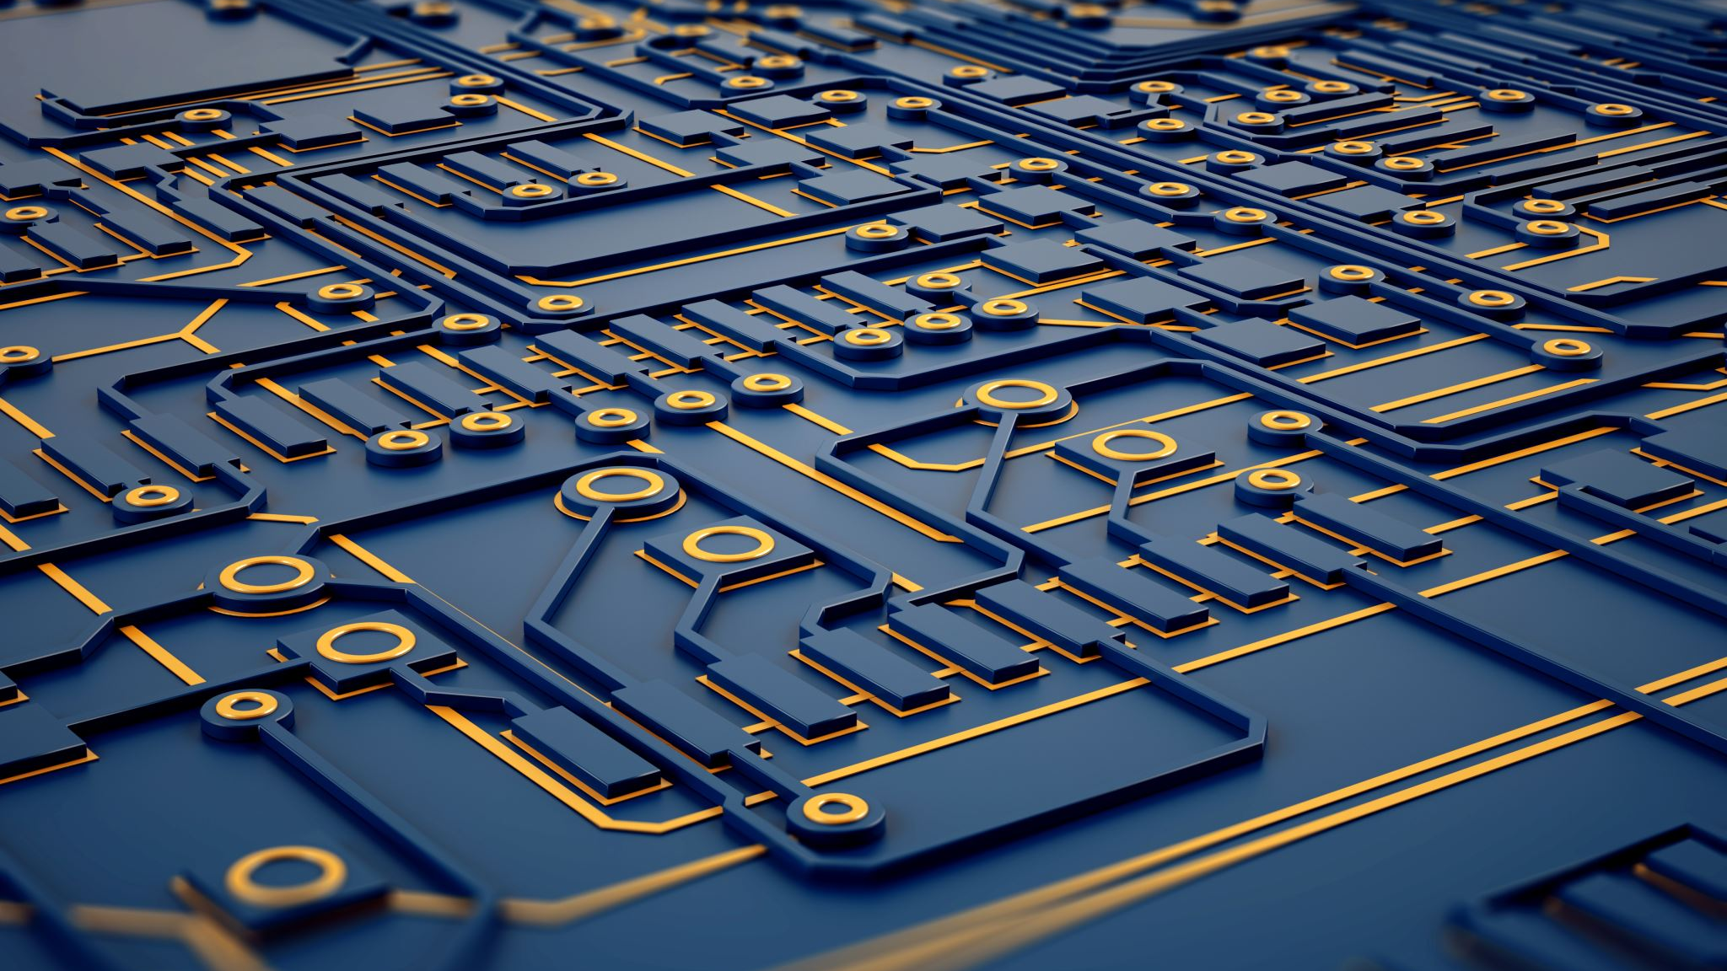
INTRODUCTION TO COMPUTER VISION
BY
ANEEL MAHMOOD

Slide 2
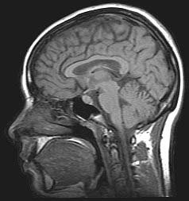
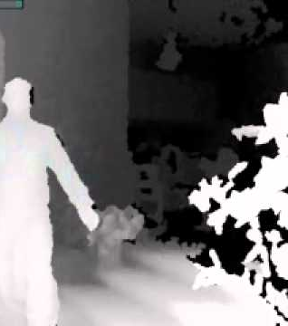

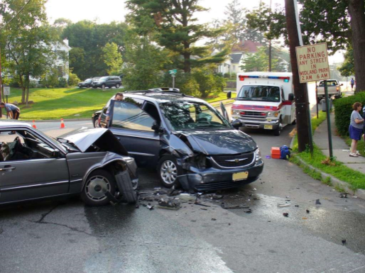
What is Computer Vision?
Computer vision is the science and technology of machines that see.
Concerned with the theory for building artificial systems that obtain information from images.
The image data can take many forms, such as a video sequence, depth images, views from multiple cameras, or multi-dimensional data from a medical scanner

Slide 3
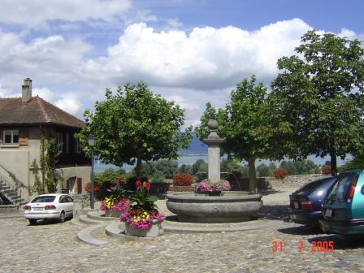
Computer Vision
Make computers understand images and videos.
What kind of scene?
Where are the cars?
How far is the building?

Slide 4

Components of a computer vision system
Camera
Lighting
Computer
Scene
Scene Interpretation

Slide 5
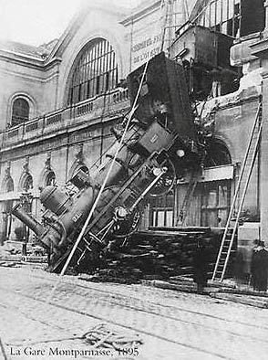
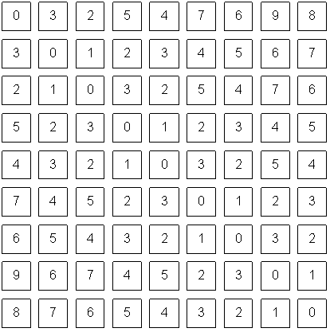
Computer Vision VS Human Vision

Slide 6
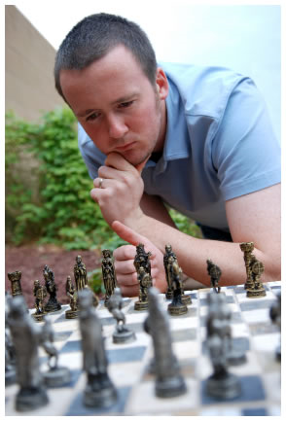
VISION IS REALLY HARD
Is that a queen or a bishop?
Vision is an amazing feat of natural intelligence
Visual cortex occupies about 50% of Macaque brain
More human brain devoted to vision than anything else

Slide 7
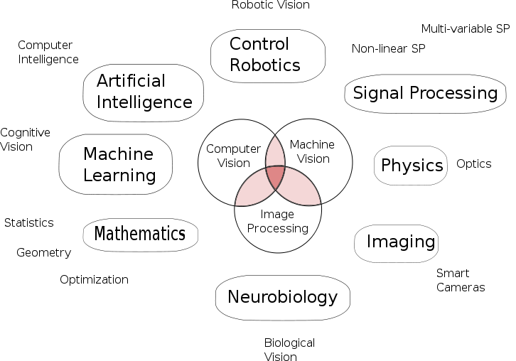
VISION IS MULTIDISCIPLINARY

Slide 8
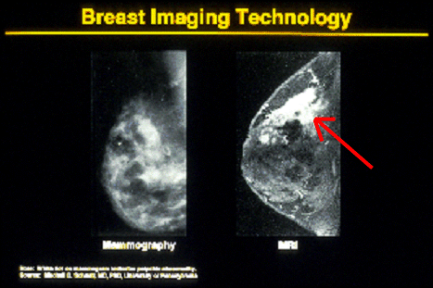

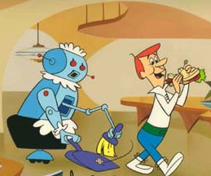
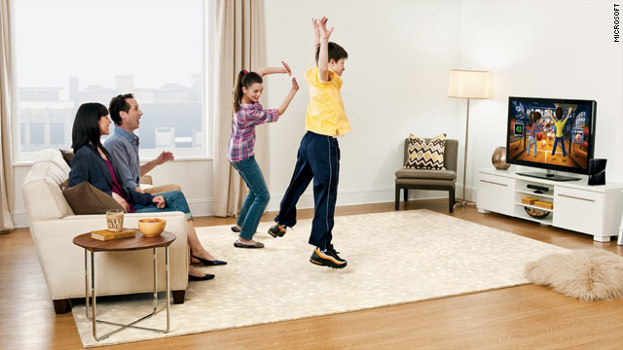
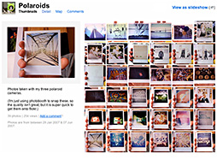
WHY COMPUTER VISION MATTERS
Safety
Health
Security
Comfort
Fun
Access

Slide 9
A LITTLE STORY ABOUT COMPUTER VISION
In 1966, Marvin Minsky at MIT asked his undergraduate student Gerald Jay Sussman to “spend the summer linking a camera to a computer and getting the computer to describe what it saw”. We now know that the problem is slightly more difficult than that. (Szeliski 2009, Computer Vision)

Slide 10
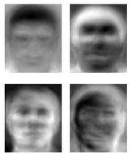
RIDICULOUSLY BRIEF HISTORY OF COMPUTER VISION
1966: Minsky assigns computer vision as an undergrad summer project
1960’s: interpretation of synthetic worlds
1970’s: some progress on interpreting selected images
1980’s: ANNs come and go; shift toward geometry and increased mathematical rigor
1990’s: face recognition; statistical analysis in vogue
2000’s: broader recognition; large annotated datasets available; video processing starts; vision & graphis; vision for HCI; internet vision, etc.
Turk and Pentland ‘91

Slide 11
APPLICATIONS OF COMPUTER VISION
Computer Vision based Mouse
Computer Vision based Text Scanner
Computer Vision based Smart Selfie
Surveillance Robot
Sixth Sense Robot

Slide 12
COMPUTER VISION BASED MOUSE
Computer vision is the technology that gives eyes to machines. Computers, Robots and Cars can "see" and perform operations based on what they see. In this course, you will build a project to make your computer's mouse move by pointing fingers in front of the computer without ever touching the mouse!
That'll be a very good start in this amazing area with great career prospects.

Slide 13
COMPUTER VISION BASED TEXT SCANNER
Computer vision is the technology that is powering the future by giving eyes to machines. Self driving cars, face recognition, reading number plates automatically etc are examples of computer vision.

Slide 14
COMPUTER VISION BASED SMART SELFIE
Computer vision is the technology behind the cool camera apps that make you look smarter! It is also the technology powering self driving cars and robots that can "see". You CAN build a project to make your computer "click a selfie" whenever you smile!

Slide 15
COMPUTER VISION BASED SURVELLANCE ROBOT
Robots are changing the world. Robots are great. Robots with eyes are even better! You can build one such surveillance robot that can be controlled from a remote location and capture live video footages.

Slide 16
COMPUTER VISION BASED SIXTH SENSE ROBOT
Robots have the potential to become the greatest industrial tool that we ever made. And robots with vision guided systems is much more efficient! You can build one such robot that can be controlled using image processing algorithms.

Slide 17
CONCLUSION
Computer Vision is more than 30 years old. Although as a research field it has been offering many challenging and exciting problems, in terms of successful engineering applications it has been rather disappointing. However, more recently, several very exciting applications have appeared where computer vision I believe can make major contributions.

Slide 18
QUESTIONS?

